Slide 1
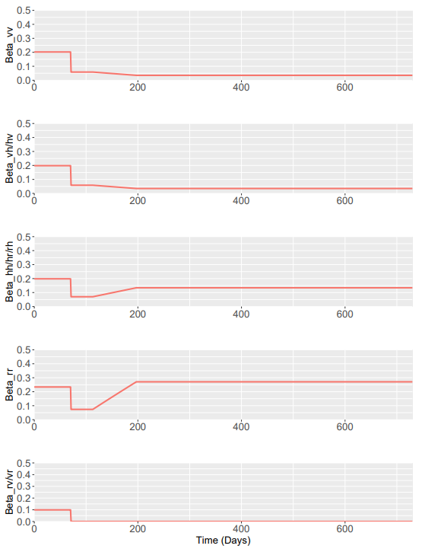
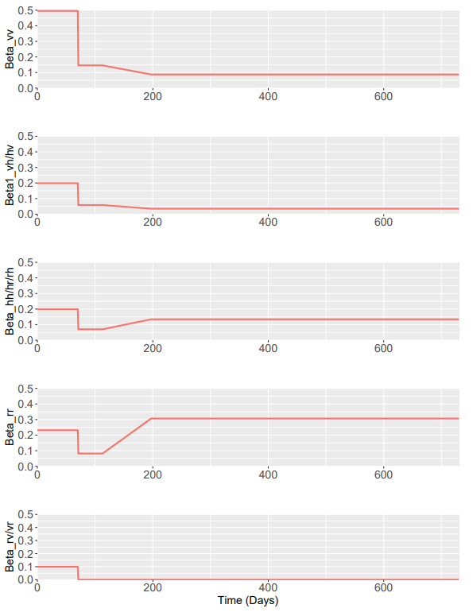
Method 1
Method 2
Phase 0 - Matrices
To\From | Vulnerable | Shielders | Remainder
Vulnerable | 0.198 *{1+delta*(beta_vr+beta_rv) * (f_v*f_v/(f_v*f_v+f_r*f_r)} | 0.198 | 0.198*(delta)
Shielders | 0.198 | 0.198 | 0.198
Remainder | 0.198*(delta) | 0.198 | 0.198 * {1+delta*(beta_vr+beta_rv) * (f_r*f_r/(f_v*f_v+f_r*f_r)}
To\From | Vulnerable | Shielders | Remainder
Vulnerable | 0.198 + 0.198*(f_nv/f_v)*(1-delta) | 0.198 | 0.198*(delta)
Shielders | 0.198 | 0.198 | 0.198
Remainder | 0.198*(delta) | 0.198 | 0.198 + 0.198*(f_v/f_nv)*(1-delta)

Slide 2
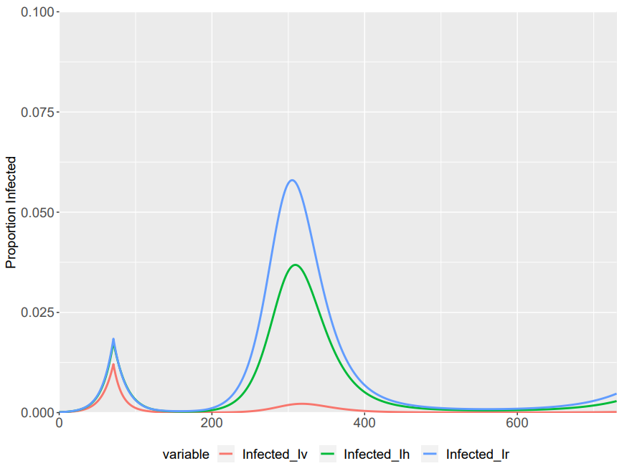
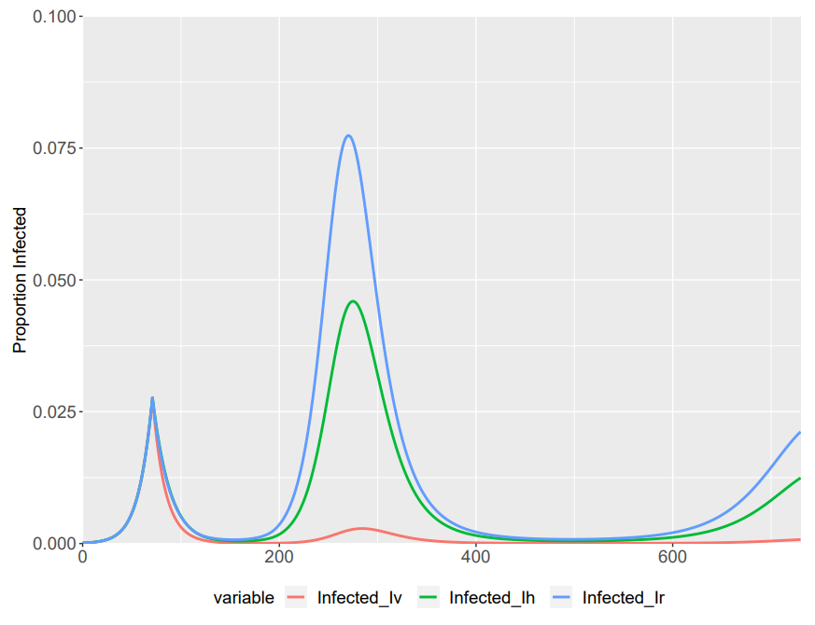
Method 1
Method 2
Phase 0 - Matrices
To\From | Vulnerable | Shielders | Remainder
Vulnerable | 0.198 *{1+delta*(beta_vr+beta_rv) * (f_v*f_v/(f_v*f_v+f_r*f_r)} | 0.198 | 0.198*(delta)
Shielders | 0.198 | 0.198 | 0.198
Remainder | 0.198*(delta) | 0.198 | 0.198 * {1+delta*(beta_vr+beta_rv) * (f_r*f_r/(f_v*f_v+f_r*f_r)}
To\From | Vulnerable | Shielders | Remainder
Vulnerable | 0.198 + 0.198*(f_nv/f_v)*(1-delta) | 0.198 | 0.198*(delta)
Shielders | 0.198 | 0.198 | 0.198
Remainder | 0.198*(delta) | 0.198 | 0.198 + 0.198*(f_v/f_nv)*(1-delta)

